Slide 1
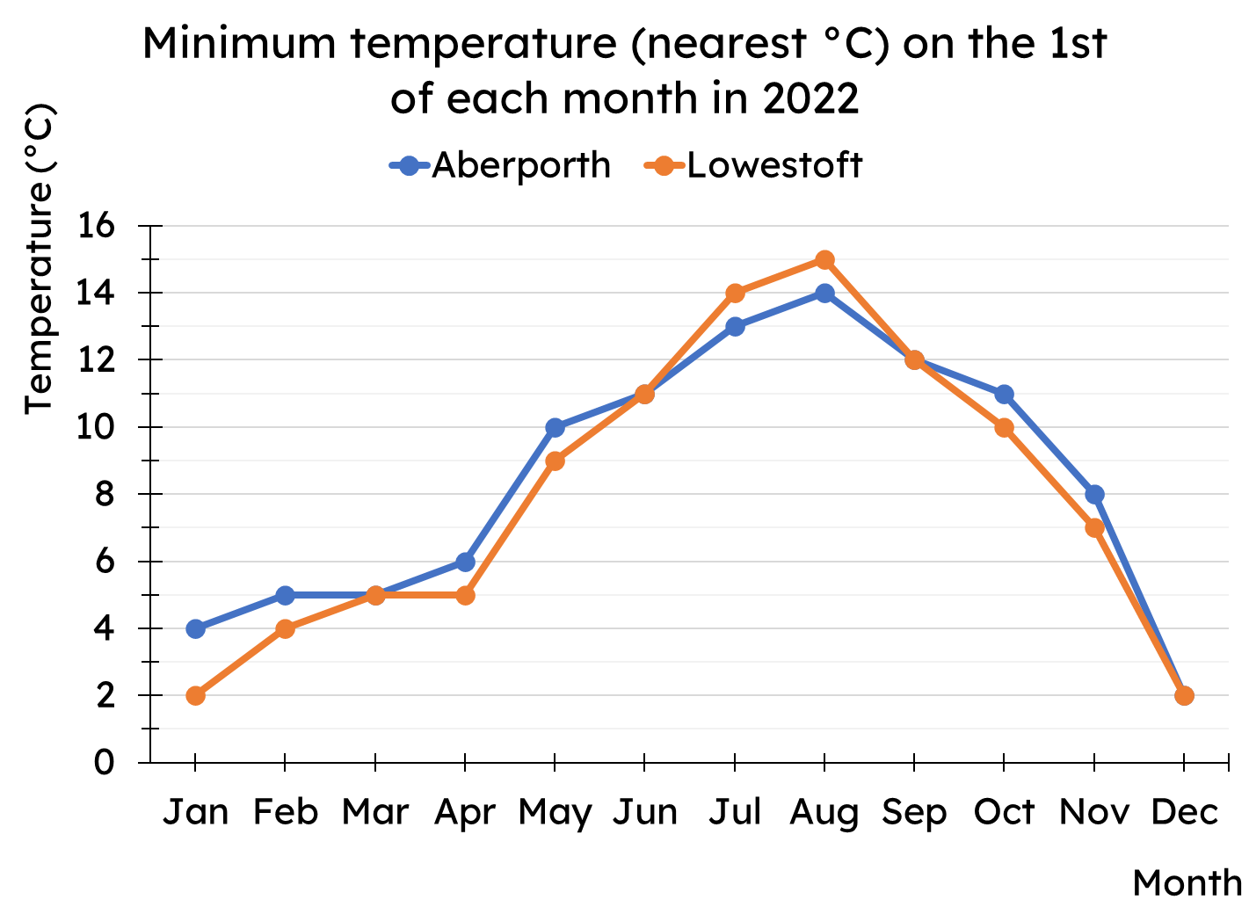
Calculating the median
Task A: Median from a line graph
Work out the median minimum temperature for both Aberporth and Lowestoft.
Aberporth 9°C
Lowestoft 8°C
Task B: Median from an ungrouped frequency table
1) Complete the missing frequencies.
star rating | frequency
1
2 | 25
3
4 | 54
5 | 31
star rating | frequency
1 | 16
2 or less | 41
3 or less
4 or less | 129
5 or less | 160
16
34
75
2) Work out the median for these data sets
a)
goals scored | frequency
0 | 12
1 | 27
2 | 43
3 | 37
4 | 10
b)
tube lines | frequency
1 | 204
2 | 53
3 | 19
4 | 5
5 | 3
6 | 1
Median goals scored is 2
Median number of tube lines is 1
c)
For each of your answers to parts a and b, justify why your answers are sensible.
Part a, the data are fairly symmetrical Part b, over 50% of the data are 1

Slide 2
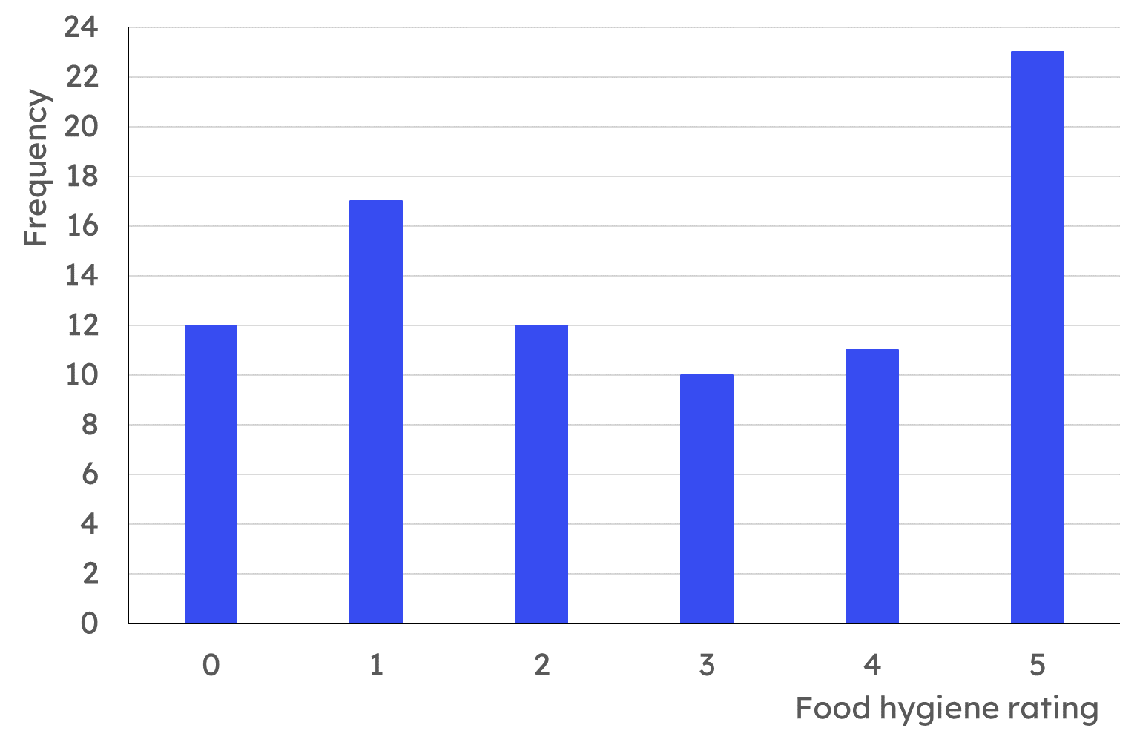
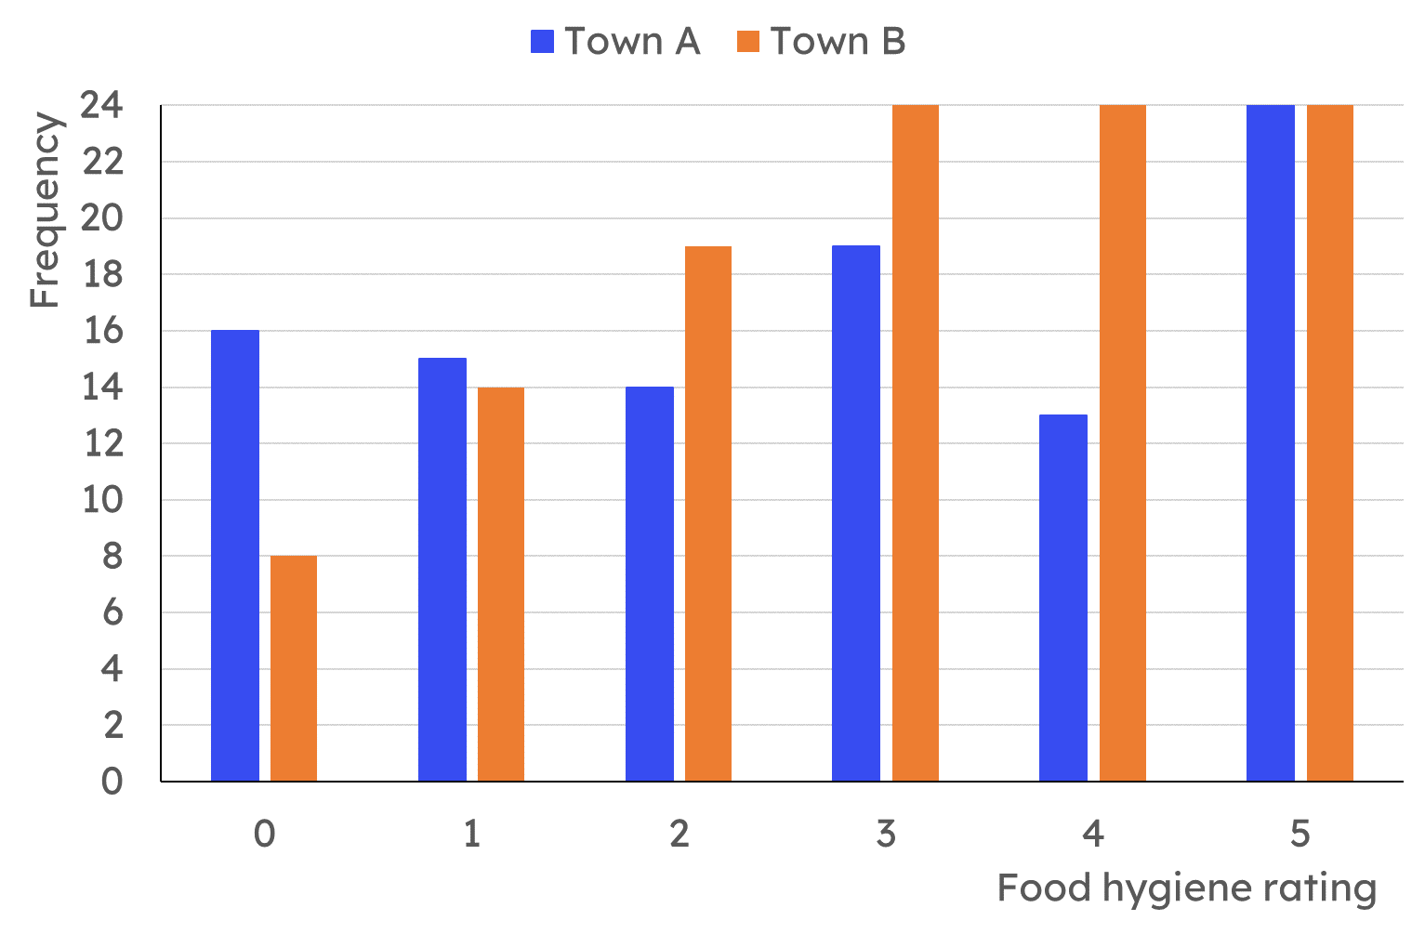
Calculating the median
Task C: Median from a bar chart
Here is a bar chart showing the food hygiene ratings for a group of local restaurants.
How many restaurants is this data about?
85 restaurants
What is the position of the median?
43rd data point
What is the median food hygiene rating?
41 pieces of data
Food hygiene rating of 3
Here is a bar chart showing the food hygiene ratings for restaurants in two towns. Calculate the median food hygiene rating for each town.
Town A:
101 ratings
Median is the 51st value
45 restaurants are 2 or less
64 restaurants are 3 or less
So the median is a rating of 3.
Town B:
113 ratings
Median is the 57th value
41 restaurants are 2 or less
65 restaurants are 3 or less
So the median is a rating of 3.
Mathematics in Education and Industry
v2.2

